Slide 1
AWS BIG DATA PROJECT

Slide 2
INTRODUCTION
In this project, JSON data is being ingested into Kinesis Data Streams and converted Apache Parquet Data Format using Amazon Kinesis Data Firehose.
After Conversion, this data is being stored in an S3 Data Lake.
This stored data is queried using Amazon Athena.
This queried data from athena is analyzed and visualized using Tableau.

Slide 3
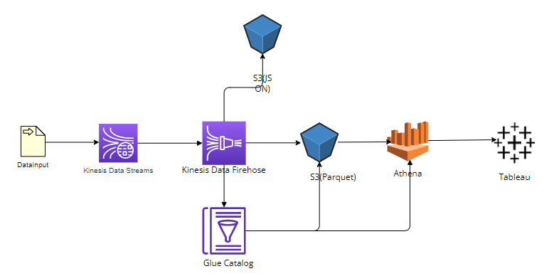
ARCHITECTURE

Slide 4
Technologies Used
AWS Kinesis Data Streams.
AWS Kinesis Data Firehose.
AWS Glue Data Catalog.
Amazon S3.
Amazon Athena.
Tableau.

Slide 5

AWS Kinesis Data Streams
Kinesis Data Streams focuses on ingesting and storing data streams.
In the project, this tool is being used to capture the ingest data quickly.
This captured data will be redirected to Kinesis Data Firehose.

Slide 6
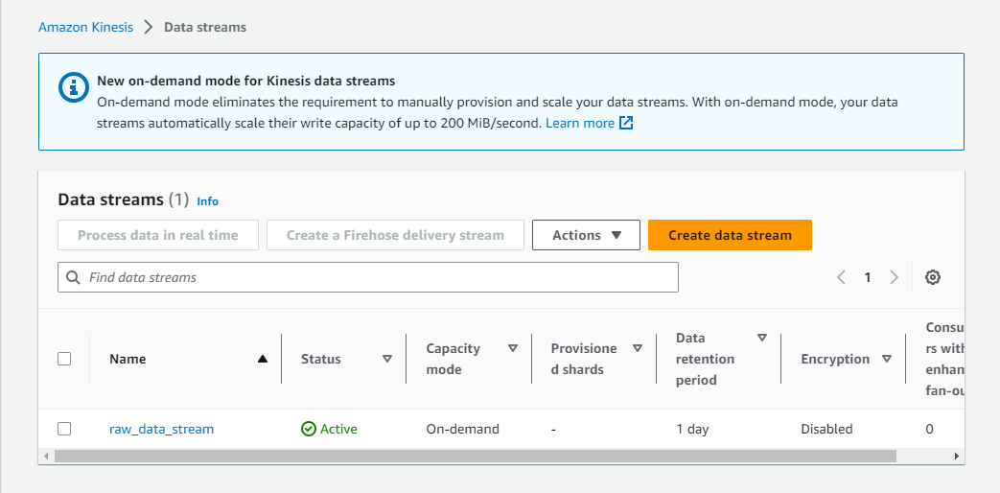

Slide 7

AWS Kinesis Data Firehose
Firehose is an extract, transform and load (ETL) service that captures, transforms and sends streaming data to data storages.
In the project, this technology is being used to capture JSON data from data streams and transform it into Parquet Data Format using Glue Catalog.
Later, this Parquet Data will be ingested to S3 Data Lake.

Slide 8
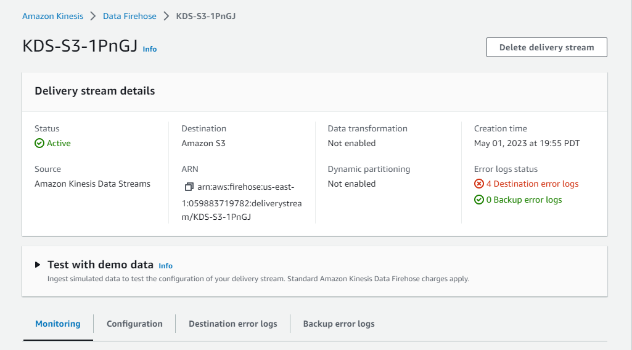

Slide 9

AWS Glue Data Catalog
Glue Data Catalog provides a unified interface to store and query information about data formats, schemas, and sources.
In the project, this technology is used to define the schema of the parquet data. Firehose, S3, and Athena use this schema to process, store, and query the parquet data.

Slide 10
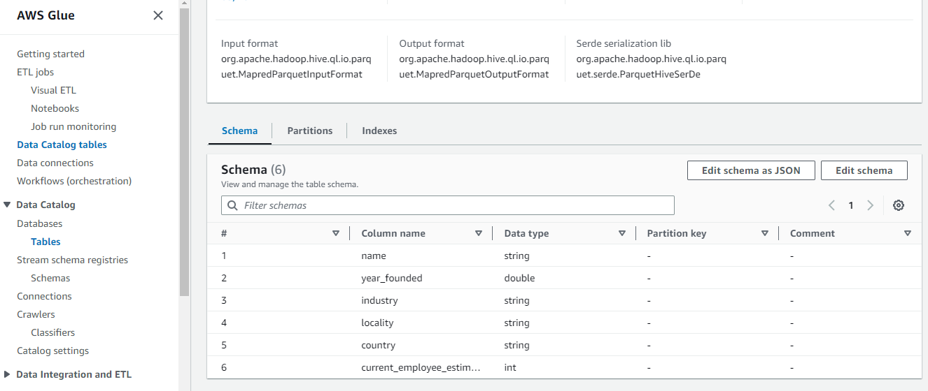

Slide 11

Amazon S3
Amazon S3 is an object storage service that is used to store and retrieve any amount of data.
Here, S3 is used to store the parquet data from firehose.
Three S3 buckets are used in this project. Namely,
apaparquetstorage.
databackups3.
aaquerytables.

Slide 12
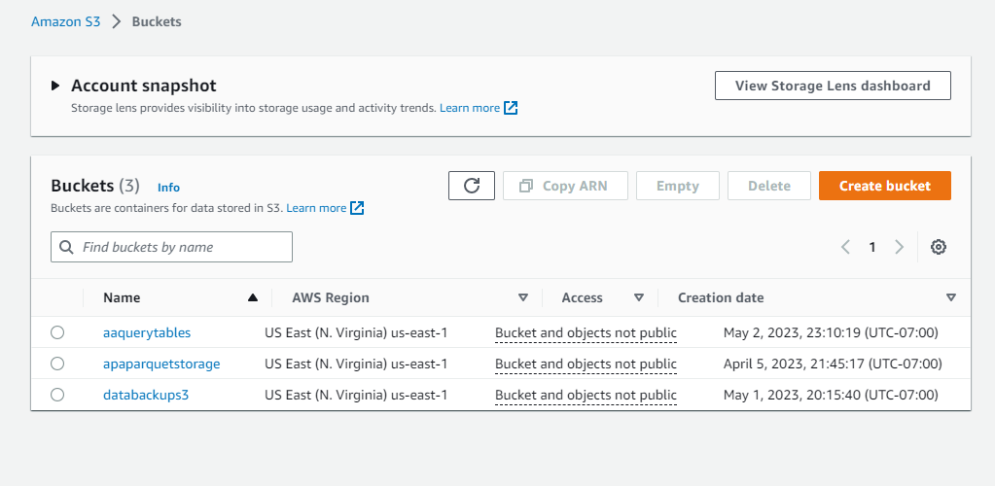

Slide 13

Amazon Athena
Athena is used to run ad-hoc queries using ANSI-SQL.
Here, athena is used to query the data from S3 Data Lake.

Slide 14
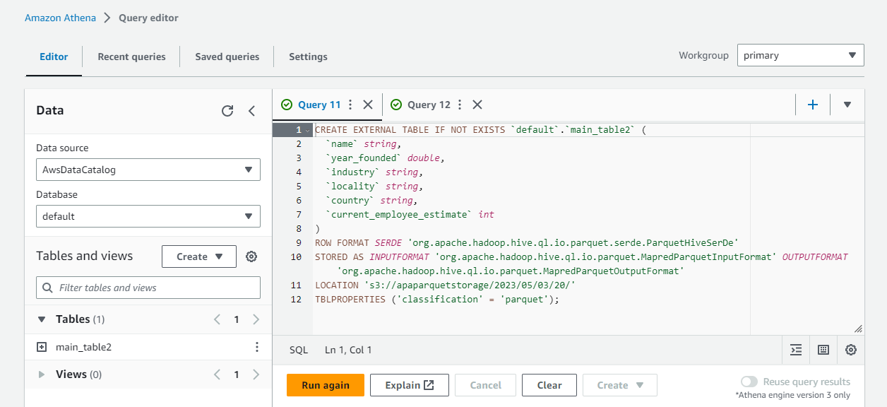

Slide 15

Tableau
Tableau is a data visualization tool which has the ability to develop comprehensive, interactive workbooks and dashboards.
Here, tableau is being used to analyse and visualise data. This resulted data can be observed to get useful insights.

Slide 16
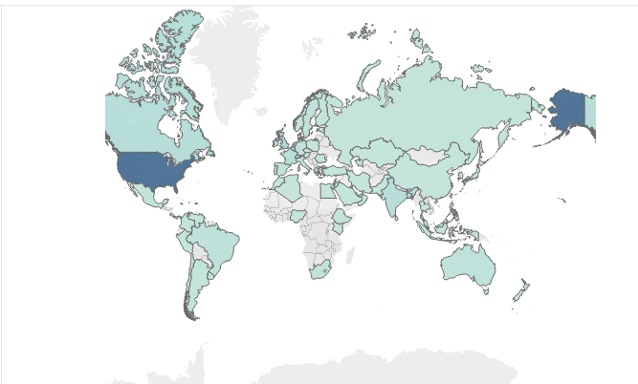
Data Visualization of number of companies originated from various countries

Slide 17
Why Parquet Format over other Data Formats?
It is hard task to access data from large CSV files, which is not ideal in Big data.
CSV files require a lot of space when compared to Parquet files. This makes using the CSV format more costly.
Whereas in Parquet format, the data is easy to access and also take up less space.

Slide 18
About Apache Parquet Data Format
Apache Parquet is an optimized columnar data format where each column has a data type it has to follow, which makes it faster to work with because it reduces the need for code that parses data types.
Parquet Data Format requires less space in storage when compared to other types.
This format is not easy for humans to read. Special file viewers are required to read the parquet data.

Slide 19
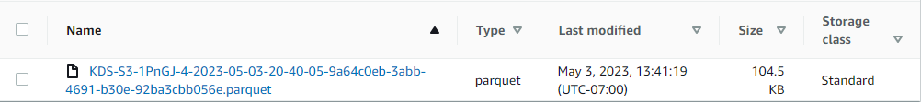
Parquet File
CSV File
A clear difference can be seen above between the sizes of a file in Parquet format and CSV Format.

